Slide 1
automatic deduction applied: automatic question answering
richard waldinger
artificial intelligence center
sri international
third summer school on formal techniques
atherton, california
23 may 2013

Slide 2
what do you mean, deductive question answering?
encode subject domain knowledge as axiomatic theory.
phrase question as conjecture.
prove conjecture in theory.
extract answer from proof.

Slide 3

forebears
mcCarthy’s advice taker (1958!):
  inferred conclusions from assertions.
  followed implied commands.
slagle’s deducom (1966):
  knowledge encoded in subject domain theory.
  answers to questions extracted from (resolution) proofs.
  early deductive question answering.
waldinger
deductive question answering

Slide 4
answer extraction
query conjecture is existentially quantified formula, exists (?x) p(?x)
theorem prover tracks substitutions for ?x.
(theorem prover restricted from substituting undefined term for ?x).
answer obtained from trace of substitutions.
    based on program synthesis
waldinger
deductive question answering

Slide 5
program synthesis
extracting programs from proofs.
arbitrary input.
conditionals from case analysis.
repetitive constructs from mathematical induction.
hard.
    green (qa3); waldinger and lee (prow); manna and waldinger
waldinger
deductive question answering

Slide 6
question answering is easy program synthesis
fixed, definite input.
no conditionals (typically).
no loops (usually).
  logic programming.
    colmerauer et al., warren, kowalski
  deductive data bases
    minker
waldinger
deductive question answering

Slide 7
subject domain theory
defines concepts in queries.
defines concepts in answers.
provides background knowledge necessary to connect them.
expressed in language of logic.
waldinger
deductive question answering

Slide 8
amphion
(planetary astronomy)
subject domain theory:
  3d trigonometry, motion.
  descriptions of subroutines to access NASA mission data, ephemeris tables.
question as schematic diagram.
rephrased as conjecture.
program extracted from proof.
consisted of sequence of subroutine calls.
    Lowry et al (NASA)
waldinger
deductive question answering

Slide 9
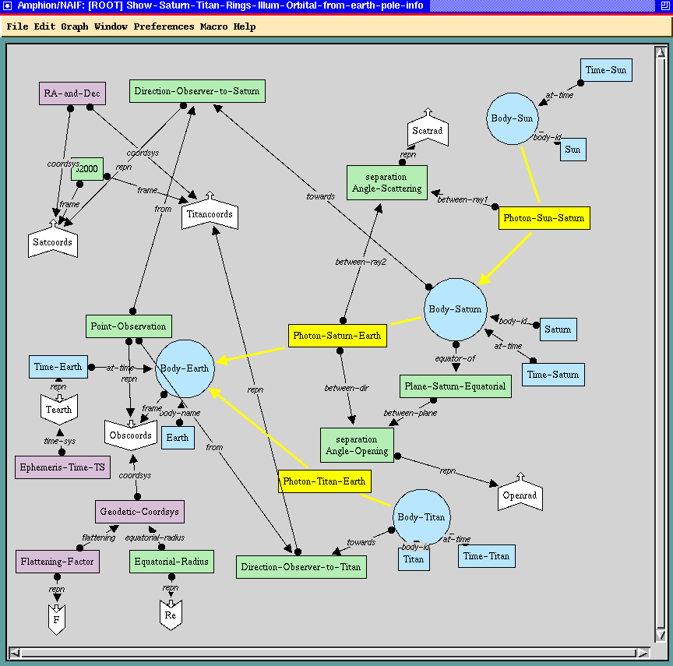
amphion graphical question
waldinger
deductive question answering

Slide 10
program extracted (fragment)
SUBROUTINE MOONP0 ( TIMECO, ANGLEI )
C Code for moon-phase-naive
C Request-id: REQ-1995-11-21-16-51-09-546
C Parameters
C EARTHN is Earth-NAIF-ID
INTEGER EARTHN
PARAMETER ( EARTHN = 399 )
C LUNANA is Luna-NAIF-ID
INTEGER LUNANA
PARAMETER ( LUNANA = 301 )
C SUNNAI is Sun-NAIF-ID
INTEGER SUNNAI
PARAMETER ( SUNNAI = 10 )
C Input variables
C TIMECO is Time-Coordinate
CHARACTER*(*) TIMECO
C Output variables
C ANGLEI is Angle-in-Radians
DOUBLE PRECISION ANGLEI
C
CALL UTC2ET ( TIMECO, E )
CALL SPKSSB ( SUNNAI, E, 'J2000', PVSUN )
CALL SPKSSB ( LUNANA, E, 'J2000', PVLUNA )
CALL SPKSSB ( EARTHN, E, 'J2000', PVEART )
CALL ST2POS ( PVSUN, PPVSUN )
CALL ST2POS ( PVLUNA, PPVLUN )
CALL ST2POS ( PVEART, PPVEAR )
CALL VSUB ( PPVSUN, PPVLUN, DPPPP )
CALL VSUB ( PPVEAR, PPVLUN, DPPPP0 )
ANGLEI = VSEP ( DPPPP, DPPPP0 )
CALL CHKOUT ( 'MOONP0' )
RETURN
END
waldinger
deductive question answering

Slide 11
animation
http://ti.arc.nasa.gov/m/project/amphion/animations/saturn-from-cassini-with-ansae.mpeg
animation produced by program extracted from proof.
waldinger
deductive question answering

Slide 12

earth from cassini
waldinger
deductive question answering

Slide 13
question answering and the Web
search engines do not understand questions or yield answers.
answer to question must be deduced from many Web resources.
hard to find the appropriate set of resources.
Web resources not designed to be used together.
composition of resources is a challenge.
waldinger
deductive question answering

Slide 14
procedural attachment
Web or local resource (data, software) linked to symbol in theory.
capabilities of resource specified by “axiomatic advertisement.”
resource consulted when symbol plays role in proof search.
information provided by resource used by proof.
resource virtually extends theory.
    Green et al. 1969; Weyhrauch ~1975
waldinger
deductive question answering

Slide 15
interoperability
representation of information yielded by one resource may differ from that required by another.
some resources are software that translates between representations.
when resources are mismatched, translation software is invoked by axiomatic advertisement + procedural attachment.
    miles vs. kilometers invokes multiplication by 1.609.
waldinger
deductive question answering

Slide 16
geoLogica and quark
query expressed in english.
parsed (by gemini) into logical form.
geographical domain theory provided with procedural attachments to Web resources.
logical form proved (by SNARK).
answer extracted from proof.
included graphical answers (satellite imagery, maps….)
    sri group project
waldinger
deductive question answering

Slide 17
a geographical query
Show a petrified forest in Zimbabwe within 200 miles of Lusaka, Zambia and north of the capital of Botswana.
show(?y) &
petrified.forest(?y) &
in(?y, zimbabwe) &
within(?y, ?z, feature(city, lusaka, zambia)) &
measure.of(?u, ?z)
mile.unit(?u) &
value.of(?u, 200) &
north.of (?y, ?v) &
capital.of(?v, botswana)
waldinger
deductive question answering

Slide 18
resources invoked for petrified forest
CIA world factbook found capital of botswana.
alexandria digital library (ADL) gazetteer supplied latitudes and longitudes for zimbabwe, botswana, zambia, lusaka, and gabarone.
ADL found “makuku fossil forest” in zimbabwe.
geographical computation software resource checked north/south relation
translation software resource transformed latitudes and longitudes.
geographical software resource checked distance between forest and lusaka (112 miles).
terraVision 3d terrain viewer displayed forest.
waldinger
deductive question answering

Slide 19
makuku fossil forest
waldinger
deductive question answering

Slide 20
subject domains
planetary astronomy
geography
intelligence analysis
molecular biology
waldinger
deductive question answering

Slide 21
cyanobacteria
bacteria that live in water and can perform photosynthesis (blue-green “algae”).
origin of atmosphere.
became chloroplast in original plants.
created oil deposits.
oldest known fossils.
waldinger
deductive question answering

Slide 22
cyanobacteria
waldinger
answering biology questions

Slide 23
high- and low-light cyanobacteria
Prochlorococcus sp. Med4 (“promed4”)
  high light (upper ocean).
Prochlorococcus marinus mit9313 (“mit9313”)
  low light (deeper ocean)
What genes are involved in the adaptation to low or high light?
    Problem formulated by Jeff Elhai
    (Virginia Commonwealth University)
waldinger
deductive question answering

Slide 24
orthologs
genes in different species with a common ancestor gene.
typically have the same function.
detectable with software (e.g., BLAST).
waldinger
deductive question answering

Slide 25
axiom: orthologs share function
function(?stimulus, ?gene1, ?organism1)
⇐
gene-has-ortholog-in-
organism(?gene1, ?gene2, ?organism2)
& function(?stimulus, ?gene2, ?organism2)
    “Orthologs share a common function”.
    “?” indicates a variable, to be plugged in.
    “stimulus”, “gene”, “organism” are sort indicators.
waldinger
deductive question answering

Slide 26
logical form of question
gene-in-organism(?gene1, promed4)
& function(light, ?gene1, promed4)
& not(exists (gene2)
ortholog(?gene1, gene2)
& gene-in-organism(gene2, mit9313))
find a light-responsive gene in promed4 that has no ortholog in mit9313.
    ?-variables have existential quantification.
    “gene” is a sort indicator.
    submit as conjecture to theorem prover
waldinger
deductive question answering

Slide 27
procedural attachment
gene-in-organism(?gene1, promed4)
?gene1 -> pmed4.pmm001,…,
.
.
pmed4.pmm0817,…,
.
.
pmed4.pmm1716
    from gene data in NCBI http://www.ncbi.nih.gov/
    Cyanobase http://www.ncbi.nih.gov/ etc.
    call a typical one pmmn
waldinger
deductive question answering

Slide 28
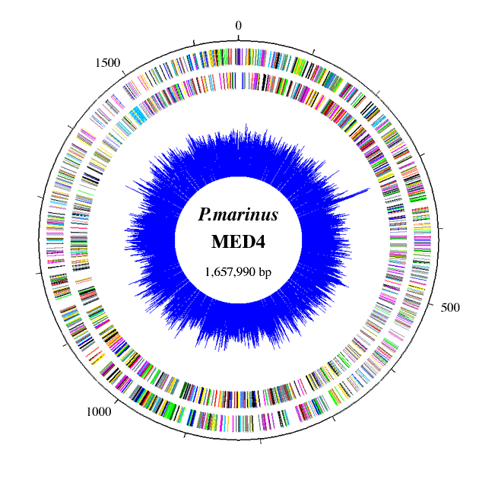

Slide 29
an axiomatic advertisement
ortholog(?gene1, ?gene2)
& gene-in-organism(?gene2, ?organism)
⇔
gene-has-ortholog-in-
organism(?gene1, ?gene2, ?organism)
    gene-has-ortholog-in-organism has procedural attachment to BLAST software.
    rewrites subformula.
waldinger
deductive question answering

Slide 30
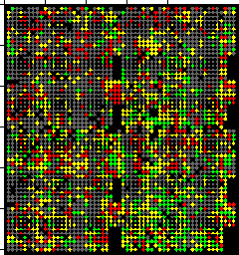
microarray experiments
genes distributed in multiple rectangular arrays.
some arrays placed in light, others not.
RNA production of arrays compared.
waldinger
deductive question answering

Slide 31
microarray experiment axiom
function(?stimulus, ?gene, ?organism)
⇐
experiment(?stimulus, ?gene, ?organism, high)
Query rewritten to
experiment(light, pmmn, promed4, high) 
    the function of a gene can be revealed by appropriate microarray experiment.
    but no microarray experiments yet on promed4!
waldinger
deductive question answering

Slide 32
light-stress microarray experiments on s6803
Related freshwater bacterium Synechocystis sp. 6803 (“s6803”).
Light stress microarray experiments have been performed (Hihara et al.)
waldinger
deductive question answering

Slide 33
our answer
gene-has-ortholog-in-
organism(pmmn, ?gene3, ?organism3) 
& experiment(light, ?gene3, ?organism3, high) 
    ?gene1 -> pmed4.pmm0817
    ?gene3 -> s6803.ssr2595
    (so-called “hli” genes)
    ?organism3 -> s6803
waldinger
deductive question answering

Slide 34

waldinger
deductive question answering

Slide 35
rediscovery of known result
FEMS Microbiology Letters Volume 215 Page 209 October 2002 doi:10.1111/j.1574-6968.2002.tb11393.x Volume 215 Issue 2
Analysis of the hli gene family in marine and freshwater cyanobacteria
Devaki Bhayaa,*, Alexis Dufresneb, Daniel Vaulotb, Arthur Grossmana
Certain cyanobacteria thrive in natural habitats in which light intensities can reach 2000 μmol photon m2 s1 and nutrient levels are extremely low. Recently, a family of genes designated hli was demonstrated to be important for survival of cyanobacteria during exposure to high light. In this study we have identified members of the hli gene family in seven cyanobacterial genomes, including those of a marine cyanobacterium adapted to high-light growth in surface waters of the open ocean (Prochlorococcus sp. strain Med4), three marine cyanobacteria adapted to growth in moderate- or low-light (Prochlorococcus sp. strain MIT9313, Prochlorococcus marinus SS120, and Synechococcus WH8102), and three freshwater strains (the unicellular Synechocystis sp. strain PCC6803 and the filamentous species Nostoc punctiforme strain ATCC29133 and Anabaena sp. (Nostoc) strain PCC7120). The high-light-adapted Prochlorococcus Med4 has the smallest genome (1.7 Mb), yet it has more than twice as many hli genes as any of the other six cyanobacterial species, some of which appear to have arisen from recent duplication events. Based on cluster analysis, some groups of hli genes appear to be specific to either marine or freshwater cyanobacteria. This information is discussed with respect to the role of hli genes in the acclimation of cyanobacteria to high light, and the possible relationships among members of this diverse gene family.
re

Slide 36
proto-implementation bioDeducta
Theorem Proving by SNARK [M. Stickel]
Access to Data Sources via BioBike
[J. Shrager, J.P. Massar et al.]
waldinger
deductive question answering

Slide 37
snark
agenda-driven first-order-logic theorem prover.
sorted logic.
answer extraction.
procedural attachment.
special facilities for spatial and temporal reasoning.
    theory-specific strategic controls
    (recursive path ordering, weighted symbols)
waldinger
deductive question answering

Slide 38
theorem proving: efficiency issues
“weights” of symbols proportional to number of answers expected via procedural attachment.
invocation of procedural attachments postponed.
cheaper procedural attachments preferred.
  e.g. genes in organism vs. orthologs in organism.
waldinger
deductive question answering

Slide 39
extension to theory: reactions and pathways
reactions viewed as rewriting of bag of chemical entities.
    input
    output
    disablers
parallel composition of reactions.
iteration.
waldinger
deductive question answering

Slide 40
explanation provided by proof
each axiom provided with an English paraphrase.
list axioms in English.
include results of invocation of procedural attachment, with source.
disregard reasoning.
provenance as well as explanation.
waldinger
deductive question answering

Slide 41
consistency and correctness
Reason forward from axioms of theory until contradiction or unintended consequence derived.
Also, see if refutation does not refer to conjecture.
    inconsistencies found in
      KIF axioms.
      DAML + OIL axioms.
      Kestrel theory library.
waldinger
deductive question answering

Slide 42
quadri: english access to hiv data
analysis of patient records.
study of development of resistance to drugs.
uses temporal reasoning, seeks patterns.
    Cleo Condoravdi, Danny Bobrow, Kyle Richardson
    PARC
    Robert Shafer, Soo-Yon Rhee, Stanford HIV Drug Resistance Database
    with Amar Das
    Stanford Medical Informatics
waldinger
deductive question answering

Slide 43
natural language
queries expressed in English.
translated into a conjecture in logical form.
sequences of questions.
collaborators from PARC.
  XLE + Bridge
  parsed Wikipedia (Powerset).
waldinger
deductive question answering

Slide 44
complex queries: multiple questions
Find patients who had a high viral load after 24 weeks on Atripla;
the patients exhibited M184v near the end of the failing regimen;
the patients switched to a salvage regimen with boosted EFV.
waldinger
quadri

Slide 45
sequence question
find a patient with a treatment change episode;
the failing regimen was at least 24 weeks long;
the patients exhibited M184v near the end of the failing regimen;
the salvage regimen had boosted EFV.
waldinger
deductive question answering

Slide 46
business application: Quest
questions about billing history with clients.
access to corporate records.
allow user to extend subject domain theory by adding new axioms in English.
  Vishal Sikka, Asuman Suenbuel, Cleo Condoravdi, Kyle Richardson
waldinger
deductive question answering

